Slide 1
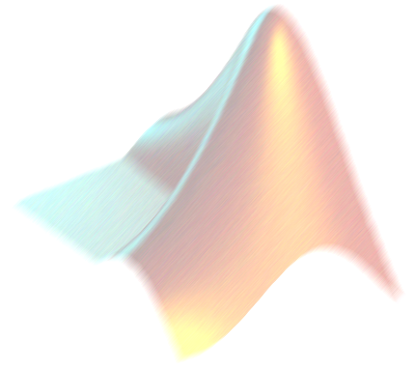

Numerical Solutions of Differential Equations:
Runge- Kutta Methods
AM2032 JAYANTA MUKHERJEE

Slide 2
Runge-Kutta Methods
Runge-Kutta methods are very popular because of their good efficiency; and are used in most computer programs for differential equations.

Slide 3
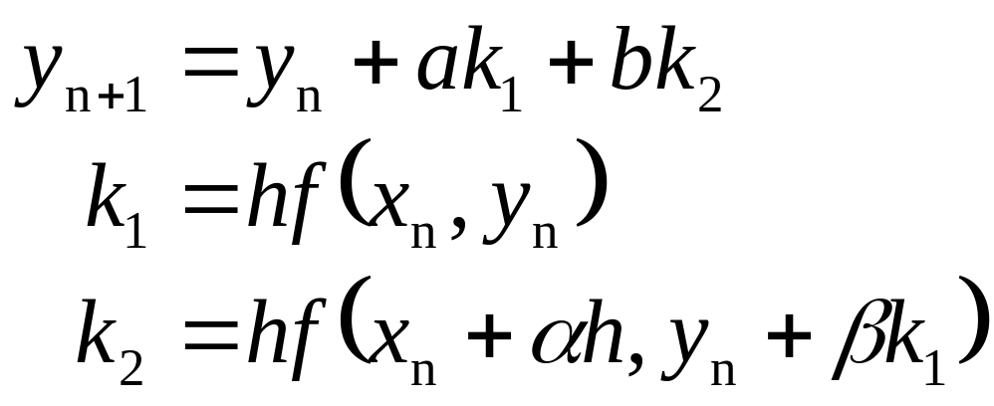
Runge-Kutta Methods
To convey some idea of how the Runge-Kutta is developed, let’s look at the derivation of the 2nd order. Two estimates
We will see what a , b , α and β mean….

Slide 4
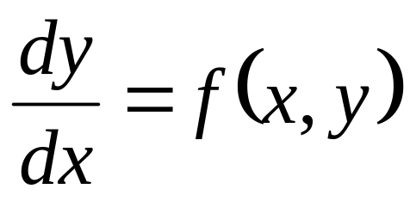
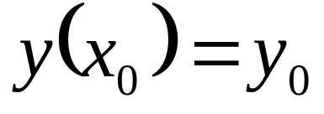
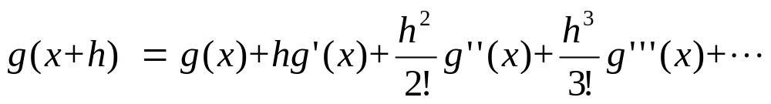
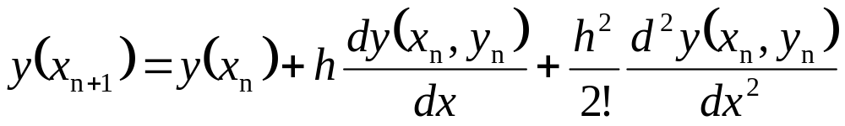
Runge-Kutta Methods
The initial conditions are:
Using the Taylor series expansion
We can write:

Slide 5
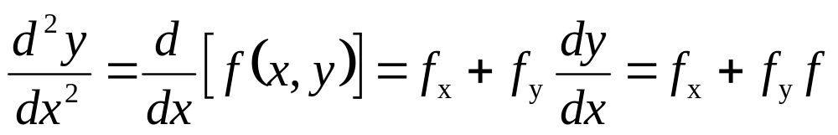
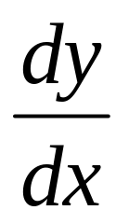
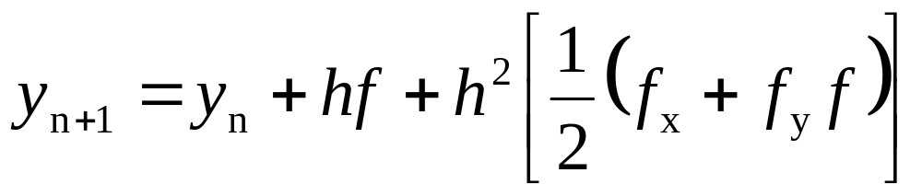
Runge-Kutta Methods
Expand the derivatives:
The Taylor series expansion becomes

Slide 6
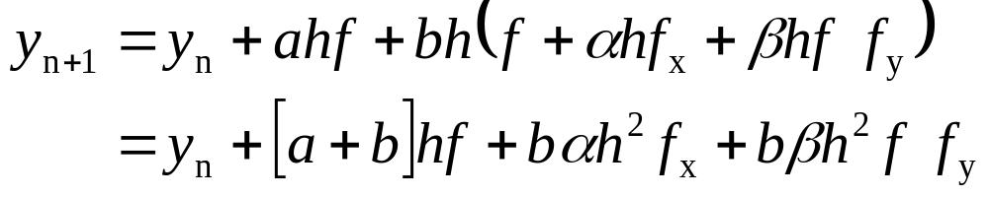
Runge-Kutta Methods
According to Runge-Kutta methods
Is written as:
The definition of the function ‘f’
Expand in the next step to get

Slide 7
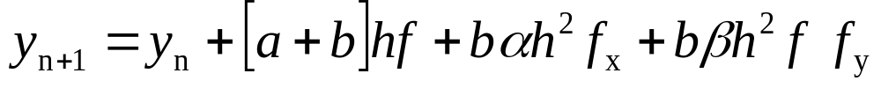
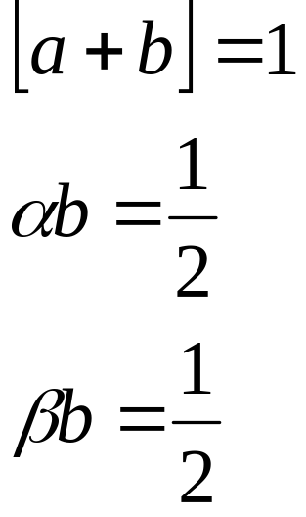
Runge-Kutta Methods
From the Runge-Kutta
Compare with the Taylor series
4 unknowns

Slide 8
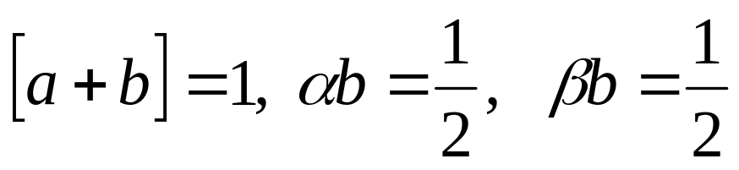
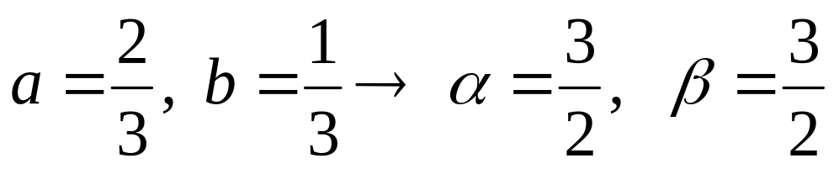
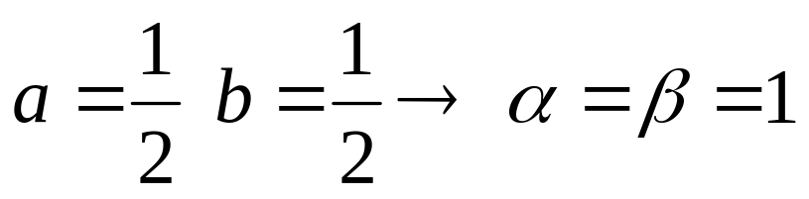
Runge-Kutta Methods
The Taylor series coefficients (3 equations/4 unknowns)
If you select “a” as
If you select “a” as

Slide 9
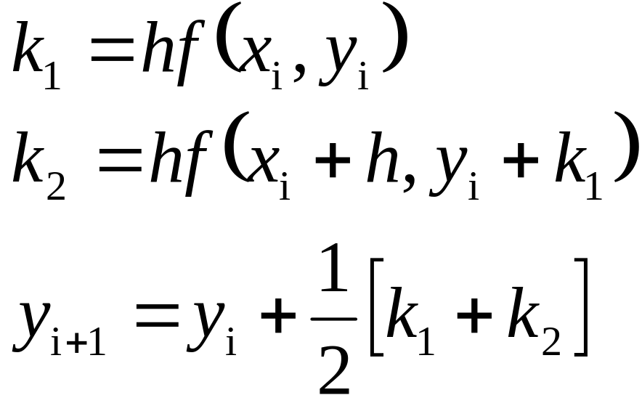
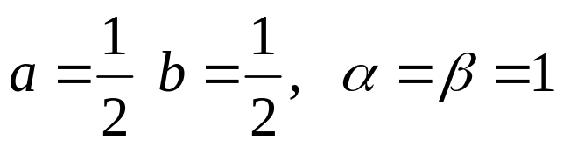
Runge-Kutta Methods
We started with:
a ,b , α and β are appropriate weights to be found
Using:
2nd Order Runge-Kutta Method or Modified Euler’s Method

Slide 10
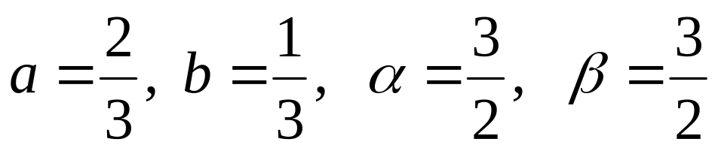
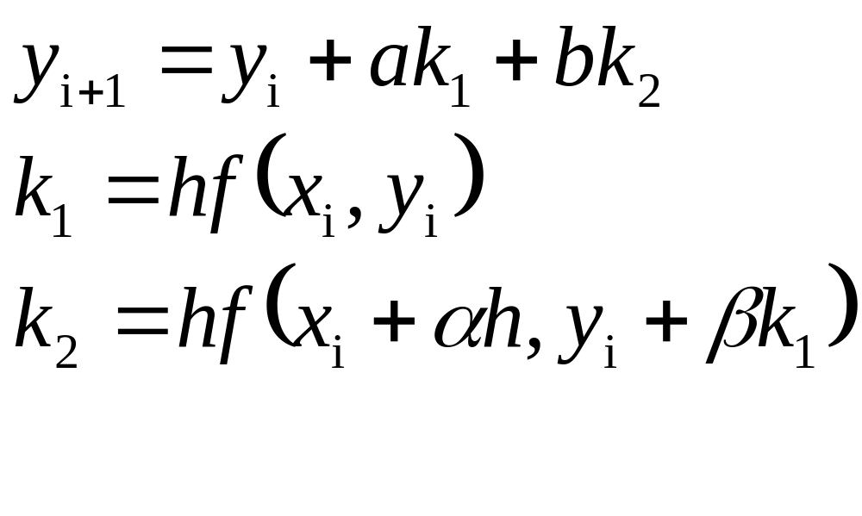
Runge-Kutta Methods
What if we choose:
the values as
2nd Order Runge-Kutta Method or Heun’s Method

Slide 11
Runge-Kutta Methods
The Runge-Kutta methods are higher order approximation of the basic forward integration. These methods provide solutions which are comparable in accuracy to Taylor series solution in which higher order derivatives are retained.
It should be noted that the equations are not need to be linear.

Slide 12
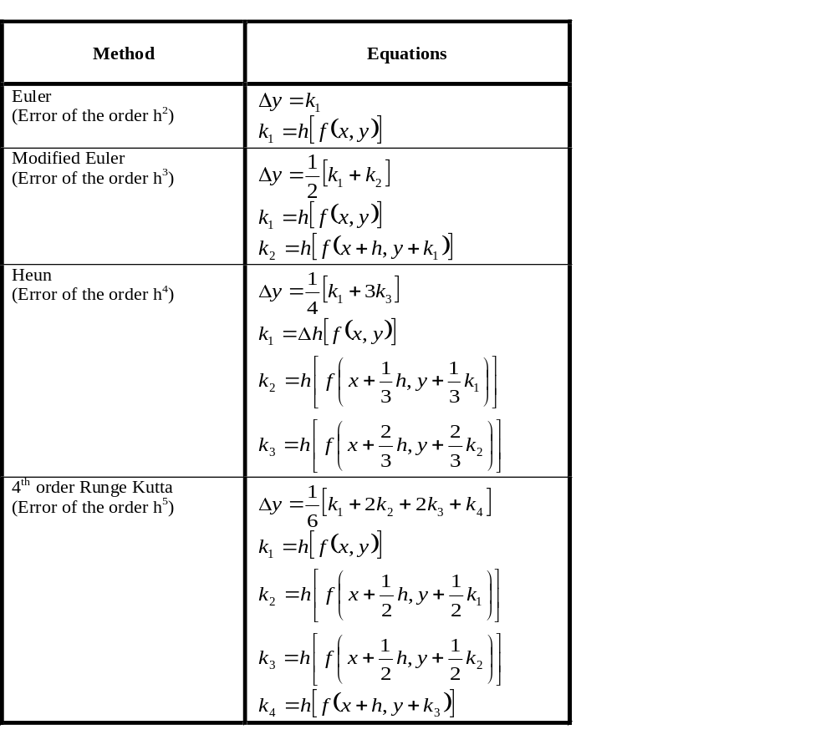
Runge-Kutta Methods

Slide 13
Runge-Kutta Methods
This is a fourth order function that solves an initial value problems using a four step program to get an estimate of the Taylor series through the fourth order.
This will result in a local error of O(h⁵) and a global error of O(h⁴)

Slide 14
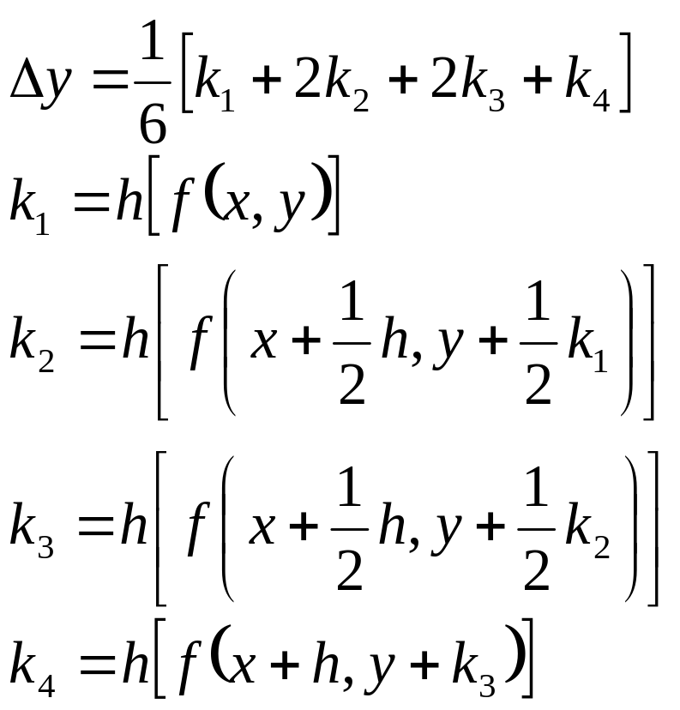
Runge-Kutta Methods
The general form of the equations for the 4th Order method are:

Slide 15

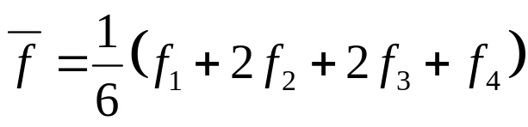
Runge-Kutta Methods
Graphical Representation of the 4rth order method:
f₂
f₄
f₃
f₁
x_{i}
x_{i} + h/2
x_{i} + h

Slide 16
Runge-Kutta Methods
Higher order differential equations can be treated as if they were a set of first-order equations. Runge-Kutta type forward integration solutions can be obtain. A more direct solution can be obtained by repeating the whole process used in first-order cases.

Slide 17
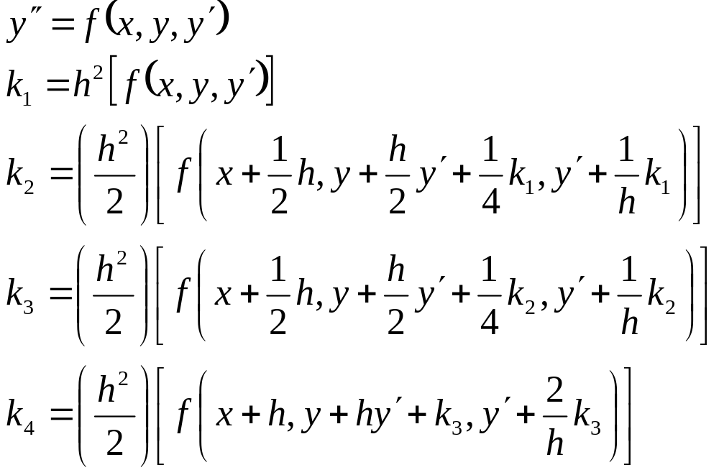
Runge-Kutta Methods
The general form of the equations for higher order differential equations are:

Slide 18
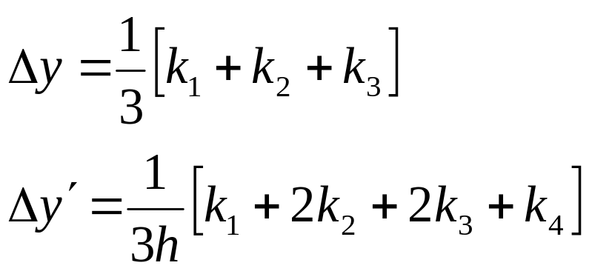
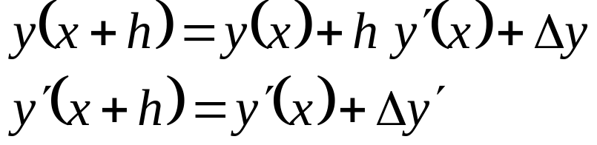
Runge-Kutta Methods
The step sizes are:
The next step would be:

Slide 19
Runge-Kutta Methods
Up until this point we have dealt with:
These methods are called single step methods, because they use only the information from the previous step.
Euler Method
Modified Euler and Heun’s Method
Runge-Kutta Methods

Slide 20
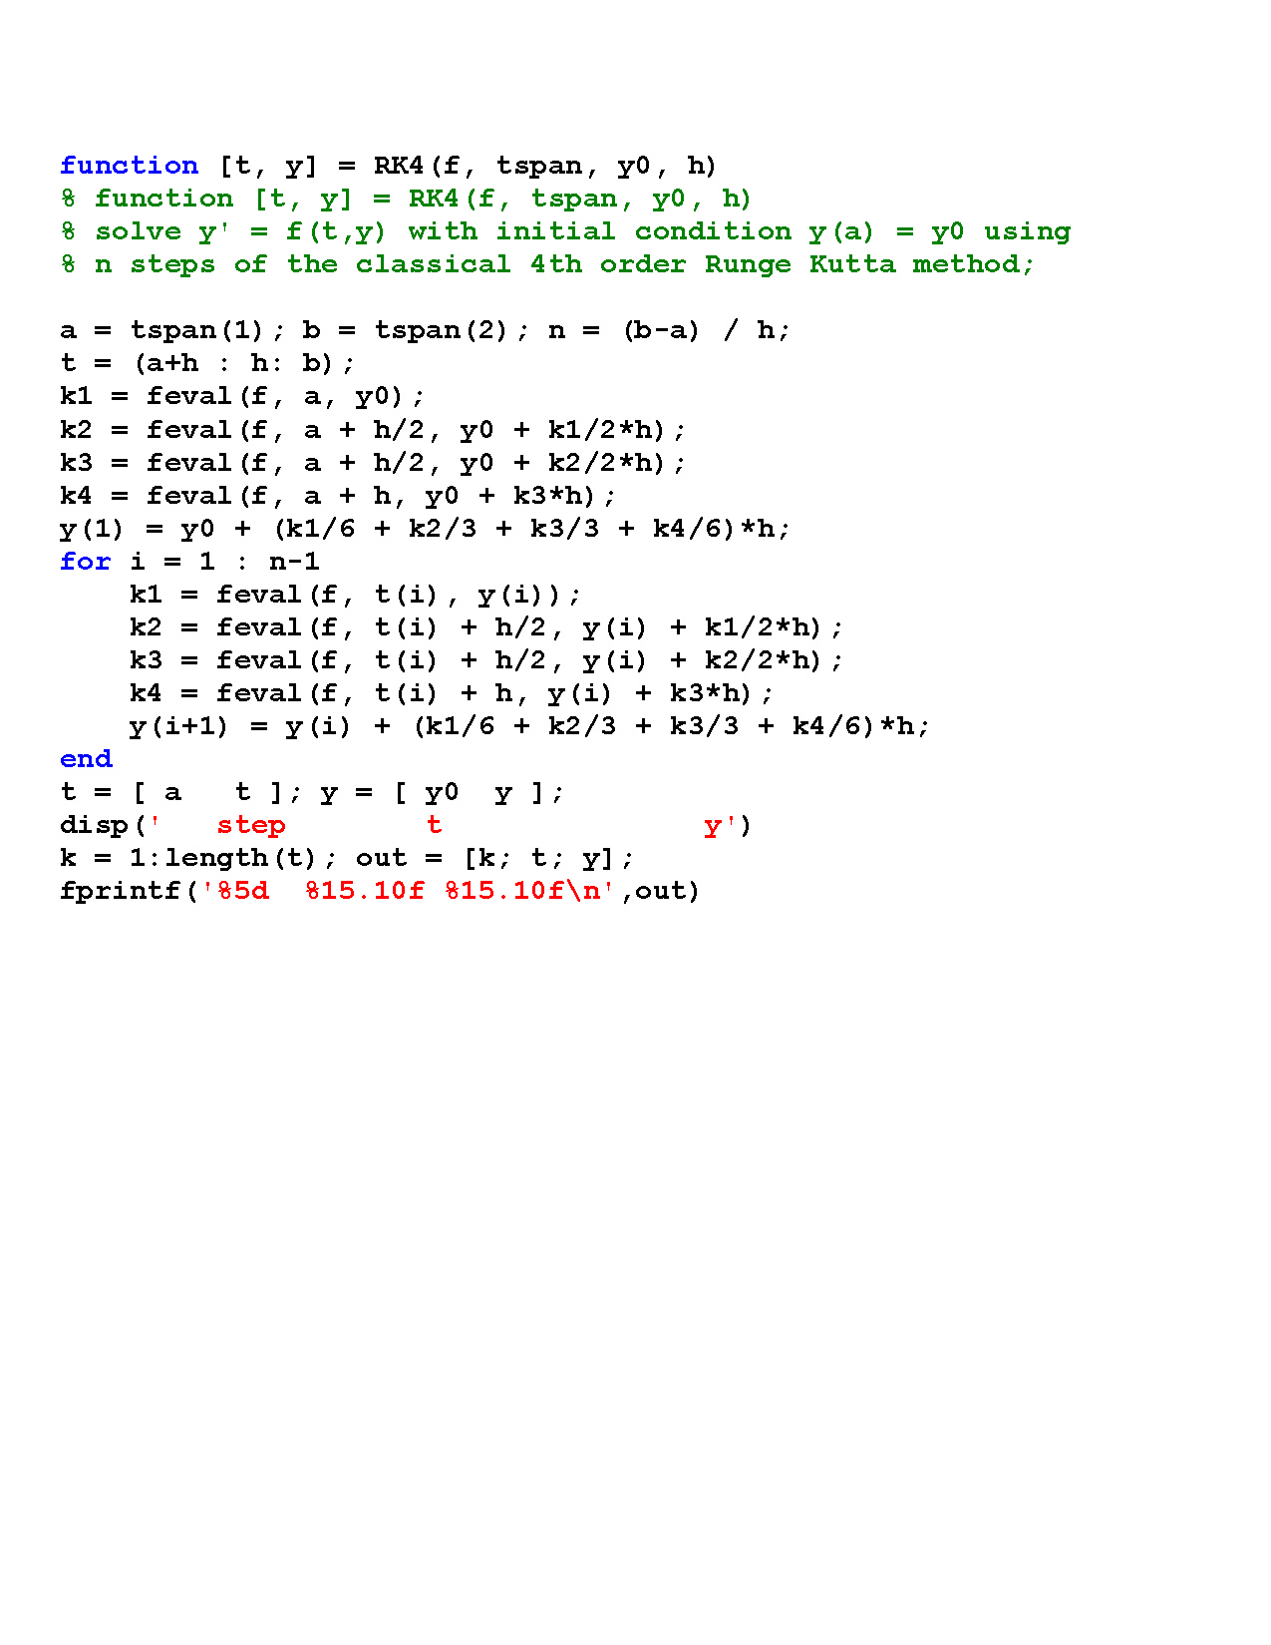
Runge-Kutta Methods

Slide 21
Single Step Method
These methods allow us to vary the step size.
Use only one initial value.
After each step is completed the past step is “forgotten: We do not use this information.
MATLAB uses 2nd and 4th order methods – “ode23” and “ode45” solvers.

Slide 22
Matlab’s ode45
ode45 is a variable step solver and is based on an explicit Runge-Kutta (4,5) formula, the Dormand-Prince pair.
ode45 needs only the solution at the immediately preceding point to compute the next value.
Dormand, J. R. and P. J. Prince, "A family of embedded Runge-Kutta formulae," J. Comp. Appl. Math., Vol. 6, 1980, pp 19-26.

Slide 23
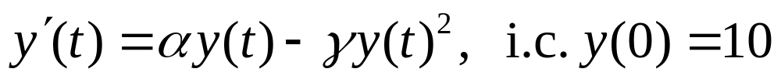
Matlab’s ode45
clear;
tspan=[0,8]; % set time interval
y0=10; % set initial condition
% fyt evaluates r.h.s. of the ode
[t,y]=ode45('fyt',tspan,y0);
plot(t,y)
[t,y] % print out t and y(t)
function yprime = fyt(t,y)
a=2; g=0.0001;
yprime = a*y-g*y^2;

Slide 24
Matlab’s ode45
clear;
tspan=[0,8]; % set time interval
y0=10; % set initial condition
% fyt evaluates r.h.s. of the ode
[t,y]=ode45('fyt',tspan,y0);
plot(t,y)
[t,y] % print out t and y(t)
function yprime = fyt(t,y)
a=2; g=0.0001;
yprime = a*y-g*y^2;

Slide 25
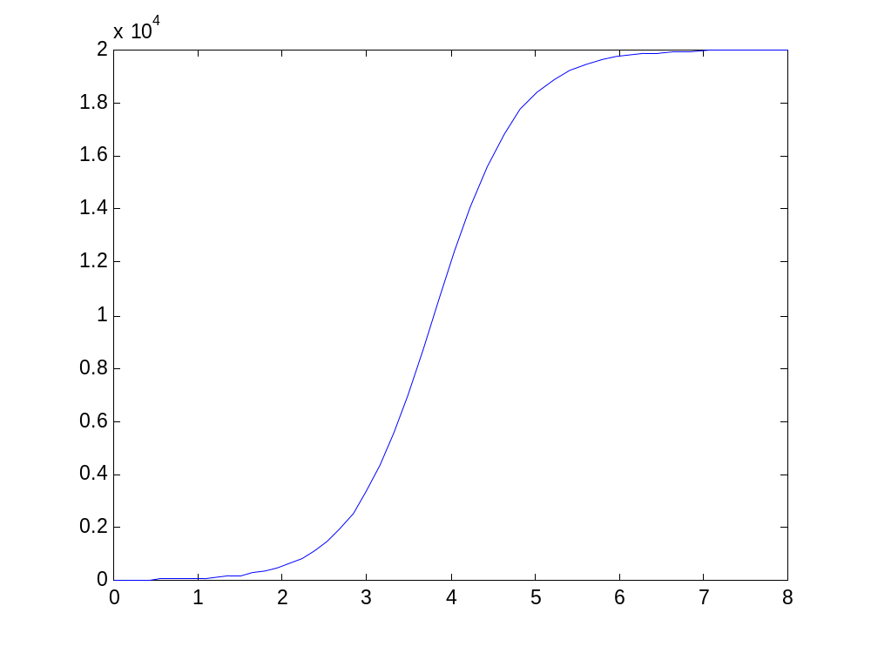
Matlab’s Plot
y(8)=19,950
Steady state
solution
as t→infinity
is α/γ=20,000.

Slide 26
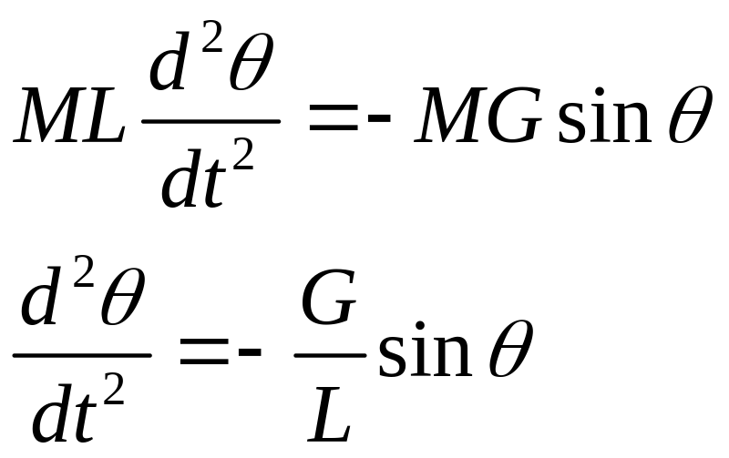

Simple Pendulum
L
M
Second order non-linear ODE. Non-linear because of sinθ.
G
To solve analytically, make the approximation sinθ~θ. This makes the ODE linear for “small amplitude oscillations”.

Slide 27
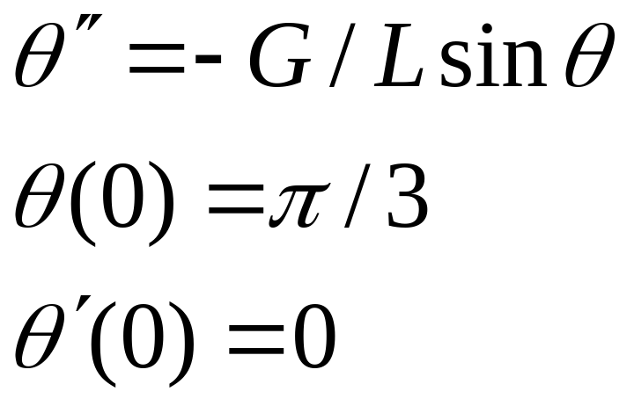
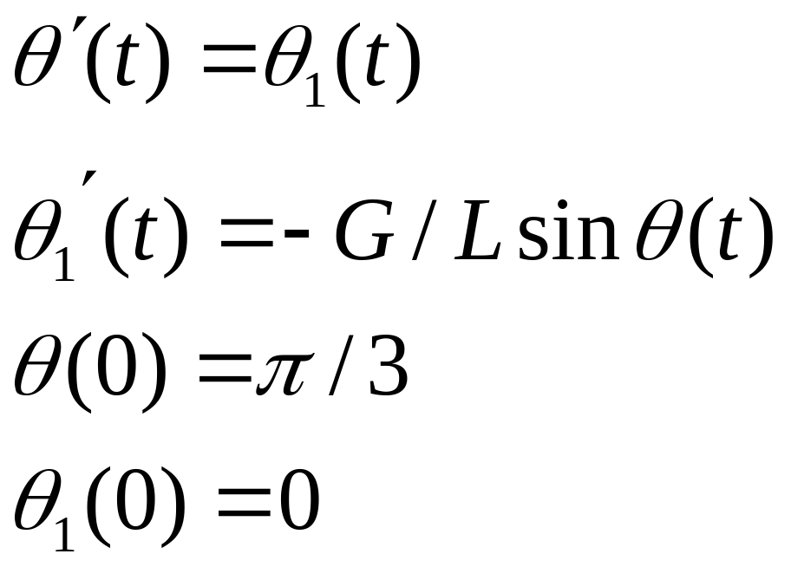
Solve Numerically
Convert 2nd order ODE
to standard form

Slide 28
Matlab Script: Non-linear Pendulum
clear;
tspan=[0,2*pi]; % set time interval
th_0=[pi/3,0]; % set initial conditions
% pend evaluates r.h.s. of the ode
[t,th]=ode45('pend',tspan,th_0);
plot(t,th(:,1))
function th_prime = pend(t,th)
G=9.8; L=2; % set constants
z=th(1); % get theta
z1=th(2); % get theta1
zprime=z1; % compute theta’
z1prime=-G/L*sin(z) %compute theta1’
th_prime = [zprime ; z1prime];

Slide 29
Matlab Script-Cont.
clear;
tspan=[0,2*pi]; % set time interval
th_0=[pi/3,0]; % set initial conditions
% pend evaluates r.h.s. of the ode
[t,th]=ode45('pend',tspan,th_0);
plot(t,th(:,1))
function th_prime = pend(t,th)
G=9.8; L=2; % set constants
z=th(1); % get theta
z1=th(2); % get theta1
zprime=z1; % compute theta’
z1prime=-G/L*sin(z) %compute theta1’
th_prime = [zprime ; z1prime];

Slide 30
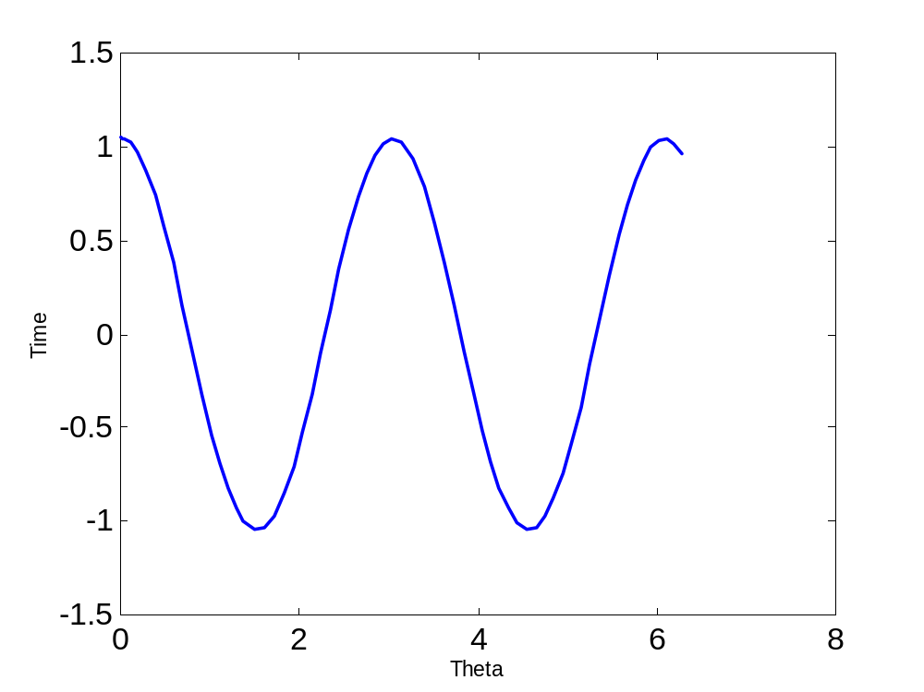
Matlab’s Plot

Slide 31
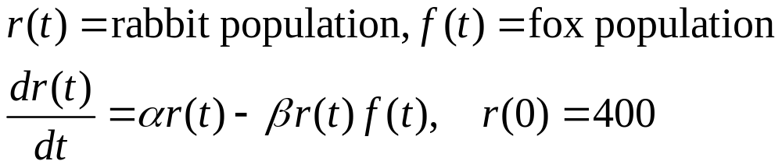
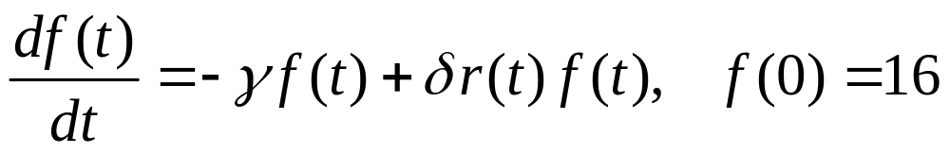
A predator-prey model
Rate of change
of rabbits
Birth-natural death
rate term
Foxes eat rabbits-
death rate due to foxes
Rate of change
of foxes
Compete for
food-no rabbits
More rabbits, more food
so more foxes

Slide 32
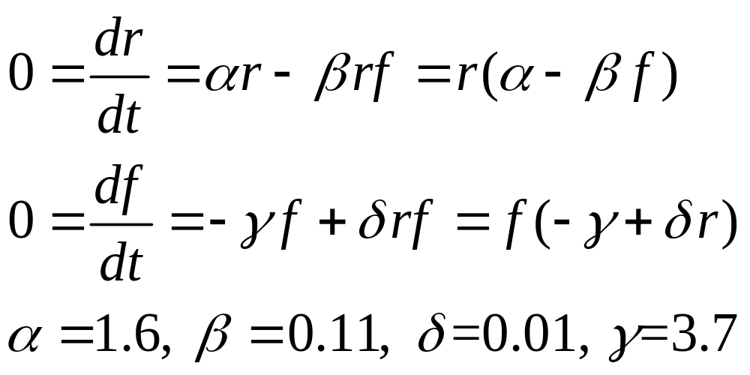
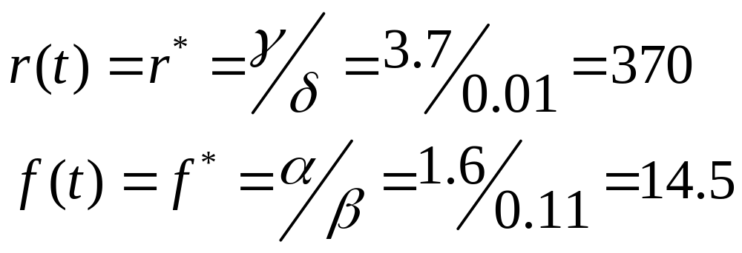
Seek Equilibrium Solutions for
Rabbit and Fox Populations

Slide 33
Matlab Script
clear;
tspan = [0, 1500]; % solution time span
f0 = 16; % number of foxes at t=0
r0 = 400; % number of rabbits at t=0
yaxes = [-20,480]; % for plotting
z0 = [r0, f0]; % i.c.’s for r(t) and f(t)
[t,z] = ode45('nonlin_rf', tspan, z0);
r = z(:,1); % extract r(t)
f = z(:,2); % extract f(t)
figure % plot over the entire time span
plot(t,r,'b', t,10*f,'k')
axis([tspan, yaxes]);
title('entire time span');

Slide 34
Matlab Script-cont
figure % plot first 10% of tspan
plot(t,r,'b', t,10*f,'k')
axis([tspan(2)*0.00, tspan(2)*0.10, yaxes]);
title('first 10% of time span');
figure % plot last 10% of tspan
plot(t,r, 'b', t,10*f,'k')
axis([tspan(2)*0.90, tspan(2)*1.00, yaxes]);
title('last 10% of time span');

Slide 35
Matlab Script-cont
figure % plot last 1% of tspan
plot(t,r, 'b', t,10*f,'k')
axis([tspan(2)*0.99, tspan(2)*1.00, yaxes]);
title('last 1% of time span');
figure % plot first 1% of tspan
plot(t,r, 'b', t,10*f,'k')
axis([tspan(2)*0.00, tspan(2)*0.01, yaxes]);
title('first 1% of time span');

Slide 36
Script to evaluate the RHS of the PDE
function zprime = nonlin_rf(t,z)
% evaluate the derivatives of r and f
r = z(1); % extract r(t)
f = z(2); % extract f(t)
alpha = 1.6;
beta = 0.11;
gamma = 3.7;
delta = 0.01;
rprime = alpha*r - beta*r*f;
fprime = -gamma*f + delta*r*f;
zprime = [rprime; fprime];

Slide 37
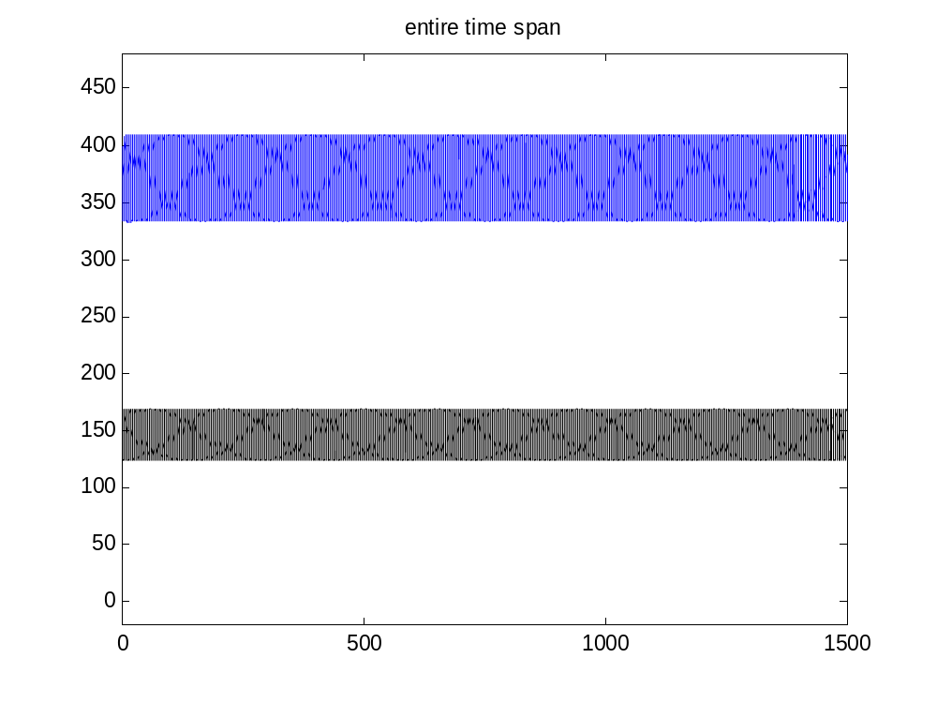
Rabbit and Fox Populations vs. Time
Rabbits
Foxes ^{x} 10

Slide 38
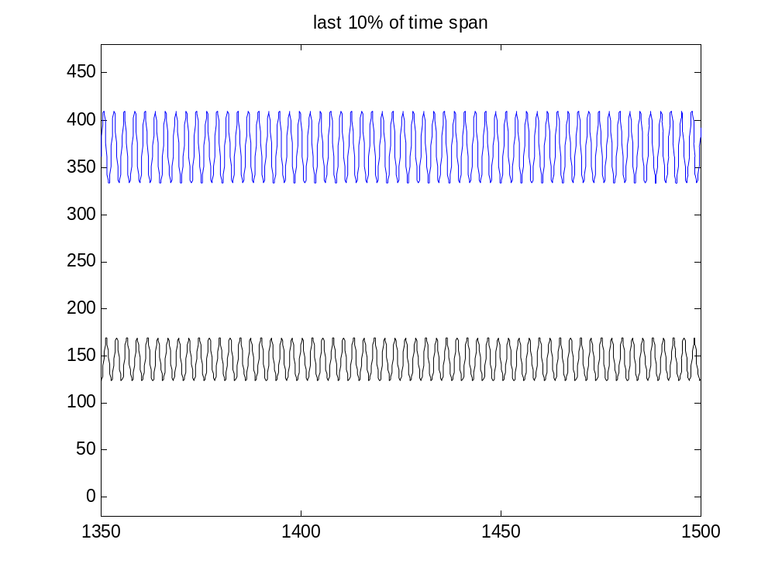
Solution of Rabbit and Fox Populations vs last 10% of time
Rabbits
Foxes ^{x} 10

Slide 39
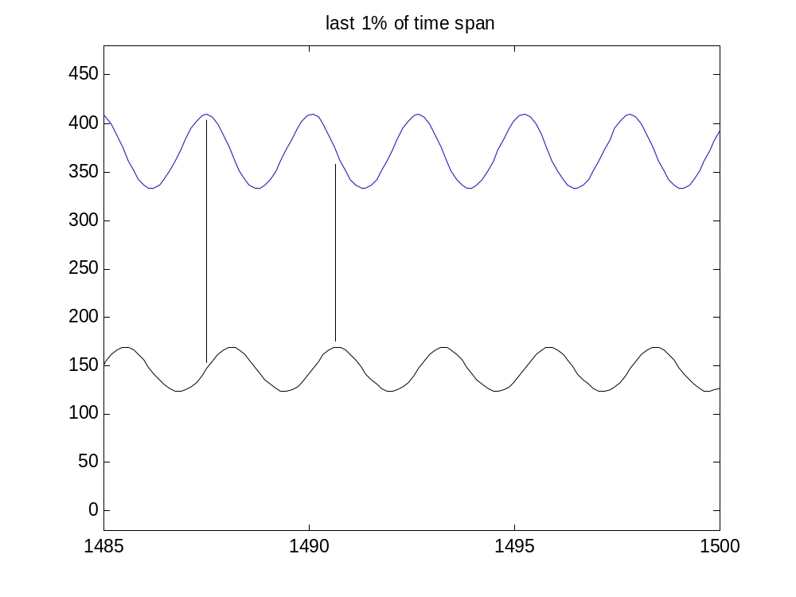
Solution of rabbit and fox populations vs. last 1% of time
r*=370
Rabbits
f*=14.5
Foxes ^{x} 10

Slide 40
Summary
Matlab has powerful built-in functions to numerically solve difficult ODE’s
The challenge is constructing the Matlab script to provide the initial conditions and call ode45 and to write the user-supplied function that evaluates the r.h.s. of the ODE’s.

